Slide 1
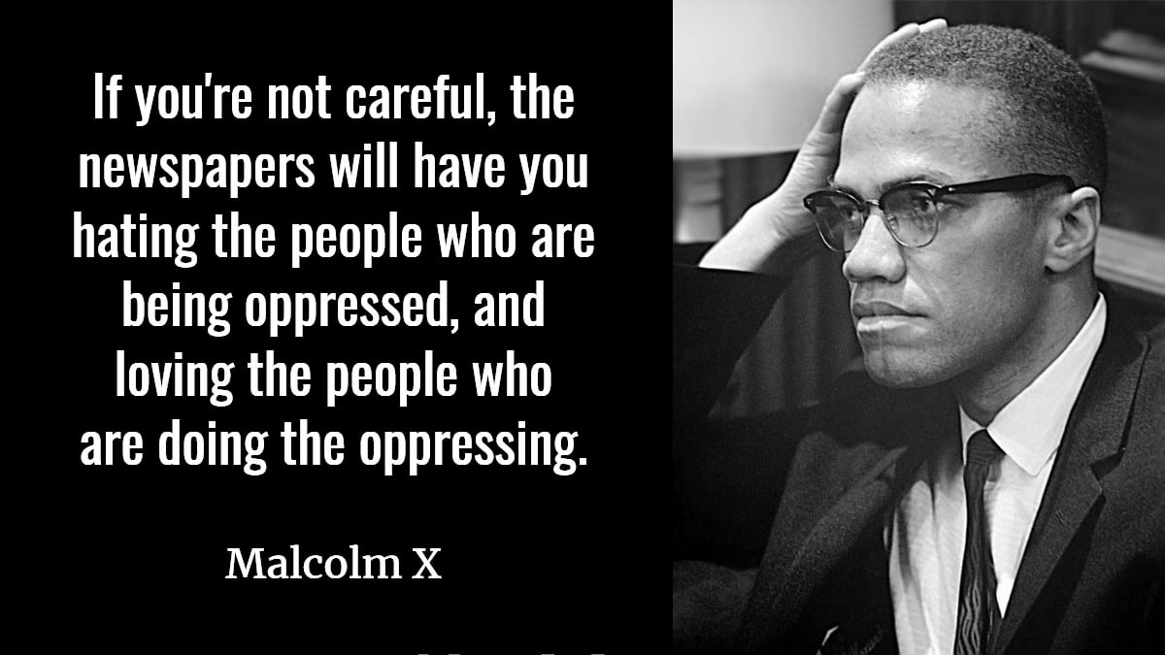

Slide 2









misleading
untrustworthy
false
unreliable
deceive
fabricated
propaganda
lie
misinformation
Notes:
Fake news refers to intentionally false or misleading information presented as genuine news. Its purpose can be to deceive, attract attention, or promote a specific agenda. It is crucial to critically assess sources to differentiate between accurate, reliable news and deliberately fabricated or misleading content. This involves fact-checking and seeking information from trustworthy sources. Various organizations work to debunk false information and educate the public on distinguishing between credible news and misinformation.
The widespread use of the term "fake news" gained prominence in the 2010s due to its increased dissemination through social media and online platforms. While misinformation and propaganda have existed for a long time, the term became highly visible, particularly after the 2016 U.S. presidential election, where discussions around the impact of false information circulated through online channels became significant. The digital age and the ease of sharing information on social media have notably contributed to the rapid spread of misleading or entirely fabricated stories, leading to a greater emphasis on addressing and combating fake news.

Slide 3
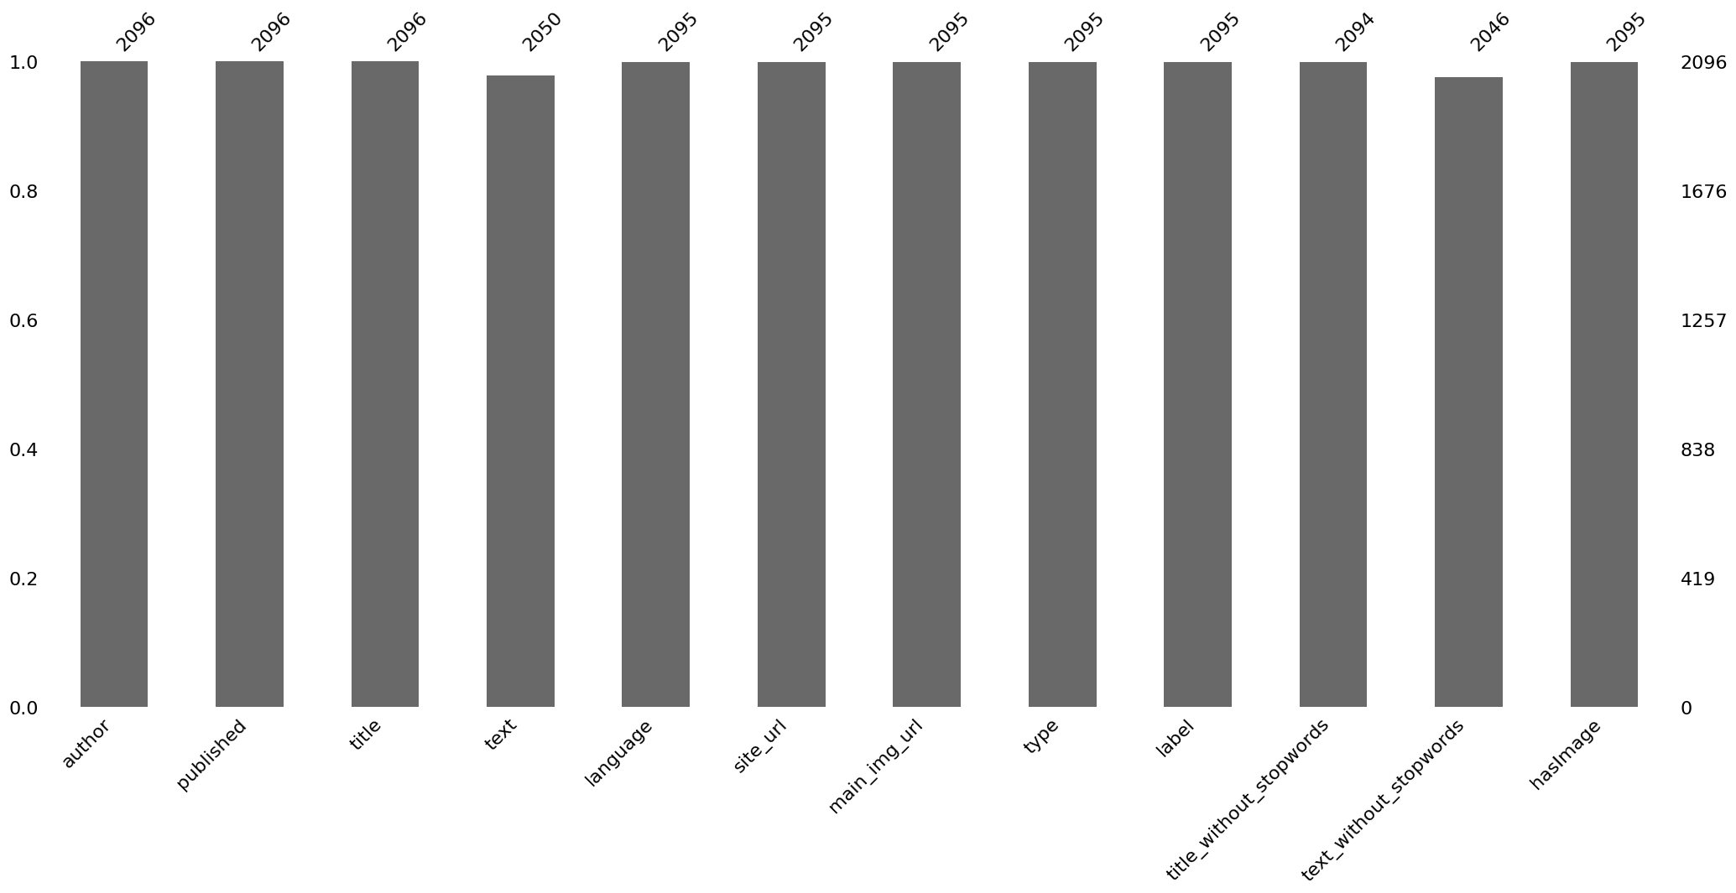

Slide 4
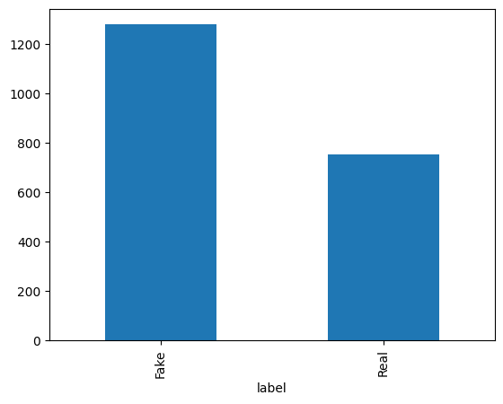
DATA
CLEANING
Missing
Values
Duplicates
Drop it
Get
Dummies
Notes:
Several missing values were identified and subsequently removed. Additionally, 10 duplicates were present in the dataset, which were also eliminated. Unnecessary columns were removed, including 'text' and 'title,' as a column already existed with the stopwords removed. Additional columns not contributing to the Machine Learning models were subsequently dropped following analysis, such as the 'time' column. The 'label' column, initially containing 'Real' and 'Fake' labels for each article, underwent a transformation to a Boolean format, represented by 0s and 1s, using the 'get_dummies' function.

Slide 5
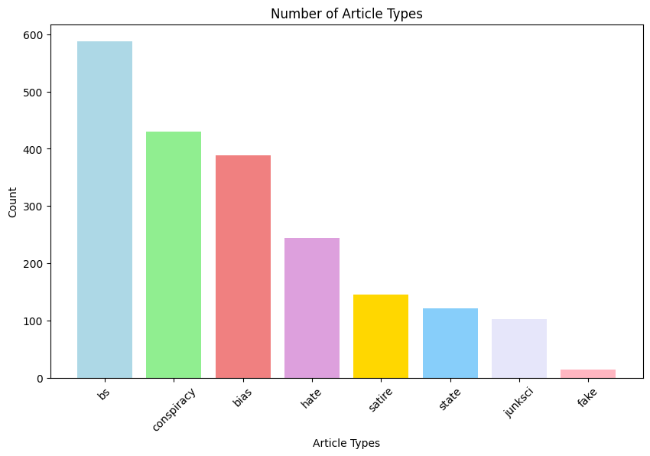
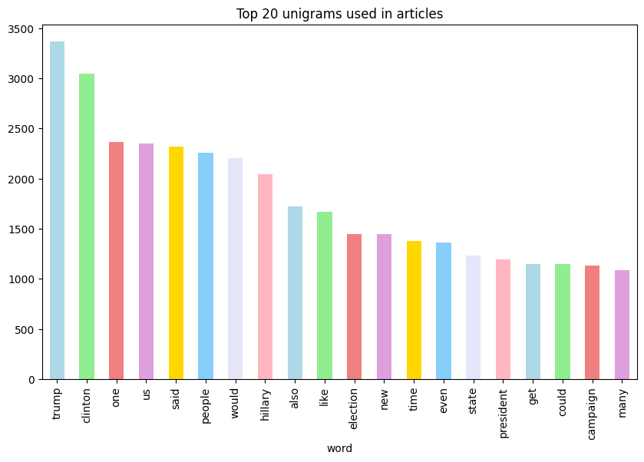
DATA
CLEANING
Missing
Values
Duplicates
Drop it
Get
Dummies
DATA
EXPLORATION
Imbalanced Data
A load of BS
Notes:
The dataset exhibited an imbalance that remained unaddressed. In order to delve deeper into the data, we could consider employing techniques like bootstrapping or oversampling to tackle this imbalance.

Slide 6
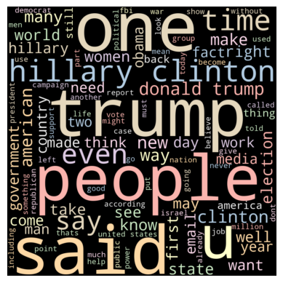
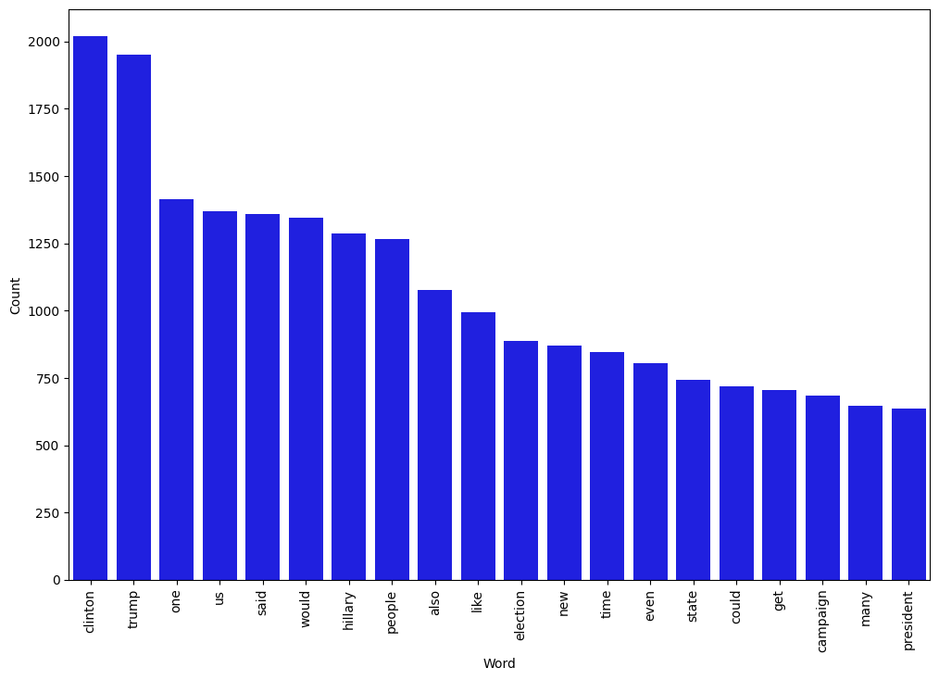
DATA
CLEANING
Missing
Values
Duplicates
Drop it
Get
Dummies
DATA
EXPLORATION
Most Common Words
ATAD
NOITAROLPXE
decnalabmI
ataD
A load of BS
Notes:
Most Common words

Slide 7
DATA
CLEANING
Missing
Values
Duplicates
Drop it
Get
Dummies
DATA
EXPLORATION
Most Common Words
ATAD
NOITAROLPXE
decnalabmI
ataD
A load of BS
Notes:
Most Common words

Slide 8
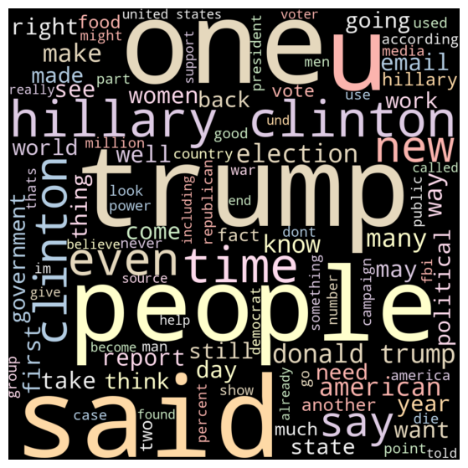
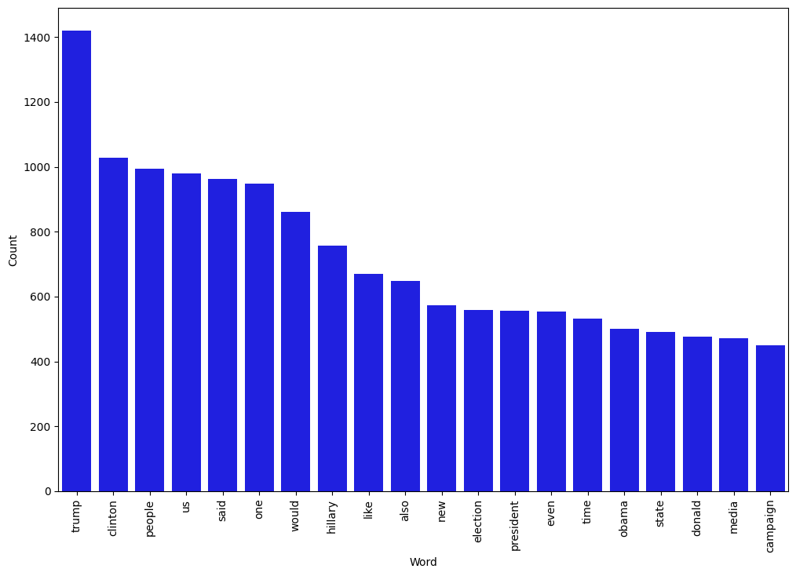
DATA
CLEANING
Missing
Values
Duplicates
Drop it
Get
Dummies
DATA
EXPLORATION
Most Common Words
FAKE NEWS
DATA
EXPLORATION
Imbalanced
Data
A load of BS
Notes:
Most Common words Fake news

Slide 9
DATA
CLEANING
Missing
Values
Duplicates
Drop it
Get
Dummies
DATA
EXPLORATION
Most Common Words
FAKE NEWS
DATA
EXPLORATION
Imbalanced
Data
A load of BS
Notes:
Most Common words Fake news

Slide 10
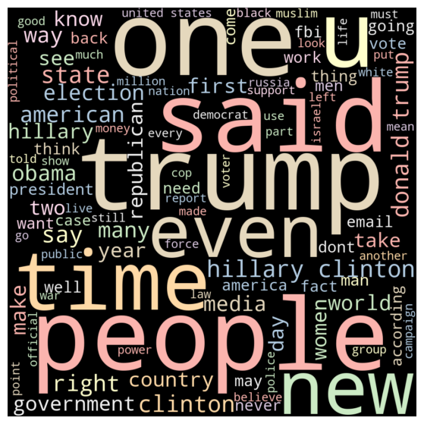
DATA
CLEANING
Missing
Values
Duplicates
Drop it
Get
Dummies
DATA
EXPLORATION
Most Common Words
REAL NEWS
DATA
EXPLORATION
Imbalanced
Data
A load of BS
Notes:
Most Common words Real News

Slide 11
DATA
CLEANING
Missing
Values
Duplicates
Drop it
Get
Dummies
DATA
EXPLORATION
Most Common Words
REAL NEWS
DATA
EXPLORATION
Imbalanced
Data
A load of BS
Notes:
Most Common words Real News

Slide 12
Images &
Fake news
A load of BS
Notes:
The dataset displayed a notable skew, predominantly comprising articles categorized as "BS." Few articles were truly classified as fake news. Instead, many of these articles contained elements of misinformation or deception, rather than being entirely and explicitly false.

Slide 13
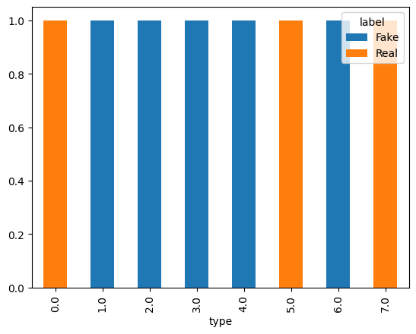
Images &
Fake news
Fake vs Real
'bias': 0, 'conspiracy': 1, 'fake': 2, 'bs': 3, 'satire': 4, 'hate': 5, 'junksci': 6, 'state': 7

Slide 14
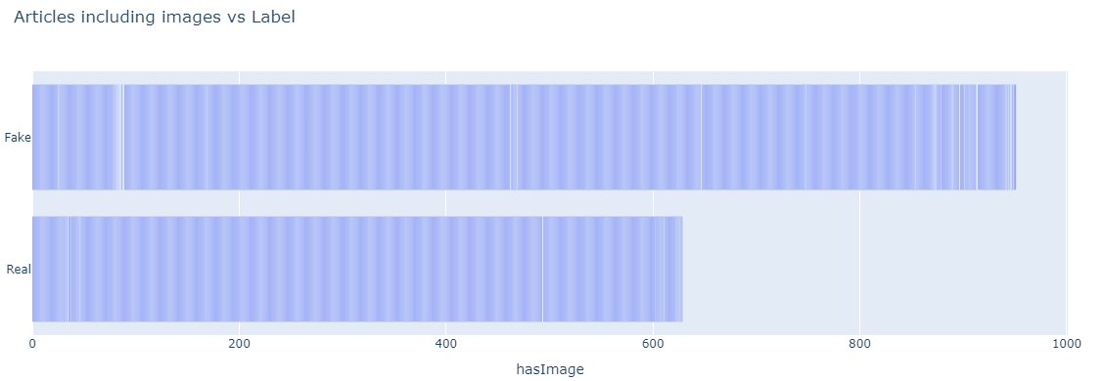
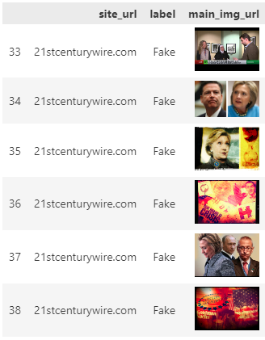
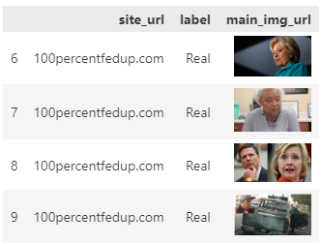
Images & Fake news
Notes:
Articles that fake tend to be accompanied by a picture

Slide 15
Images & Fake news
DATA
TRANSFORMATION
Get Dummies
Vectorized
Label Encoder
Tokenization

Slide 16
MODELS
LR - 71%
DT - 75%
GBC - 80%
RF - 77%
DATA TRANSFORMATION
Get Dummies
Vectorized
Label Encoder
Tokenization
Images &
Fake news
# Get Dummies
Numerical data
# Vectorizing and applying TF-IDF
Data Relationship
# Label Encoder
Numerical forms
# Bert Tokenizer
Patterns and Relationships
A
load
of BS
Notes:
Vectorization in the context of machine learning refers to the process of converting data, usually in the form of text or categorical variables, into a numerical format that can be used by machine learning models. This transformation involves converting words, sentences, or categorical features into numeric vectors.
The purpose of vectorization is to make the data suitable for mathematical operations and to be used as input in machine learning algorithms, which often expect numerical data. It allows the model to interpret and analyze the information effectively. There are different techniques for vectorization:
1. **One-Hot Encoding:** This method represents categorical data as binary vectors where each category is converted to a binary vector. For instance, if there are three categories, each one would be represented by a vector of length 3, with one element as 1 and the others as 0.
2. **Term Frequency-Inverse Document Frequency (TF-IDF):** It is used for text data to reflect the importance of a word in a document relative to a collection of documents. Words that occur frequently within a document but not commonly across documents receive higher scores.
3. **Word Embeddings:** Techniques like Word2Vec, GloVe, and BERT convert words or sentences into dense, lower-dimensional vectors, capturing semantic meanings and relationships between words based on their usage in a large corpus of text.
4. **Count Vectorization:** It simply counts the frequency of words within the text and represents each document as a vector of word counts.
Vectorization enables machine learning models to process and learn from data efficiently, making it easier for the model to understand the patterns and relationships in the data.
Label encoding is a method used in machine learning to transform categorical labels into a numerical format. It's primarily applied to the target variable or labels that need to be predicted by a machine learning model. This conversion is essential because most machine learning algorithms operate on numerical data, and categorical labels must be converted into numerical values for processing.
For example, if a feature column contains categories like "A," "B," and "C," a label encoder will convert these labels into numerical equivalents, such as 0, 1, and 2, respectively.
However, a potential drawback of label encoding is that it might imply ordinal relationships between the categories. This could unintentionally introduce a hierarchy or order that doesn't exist in the original data. In cases where there is no ordinal significance between the categories, alternate encoding methods such as one-hot encoding may be more suitable.
A tokenizer is a fundamental component in natural language processing (NLP) that breaks down text data into smaller units called tokens. These tokens can be individual words, characters, or subwords, depending on the specific tokenizer's design or the requirements of the NLP task.
The primary objective of tokenization is to segment the raw text into units that can be used in various NLP processes, such as parsing, text analysis, or feature generation for machine learning models.
There are different types of tokenizers:
1. **Word Tokenizer:** Splits text into words or phrases based on whitespace or other punctuation rules.
2. **Sentence Tokenizer:** Divides text into sentences, recognizing sentence boundaries.
3. **Subword Tokenizer:** Segments words into smaller subword units, particularly useful for languages with complex word structures.
4. **Character Tokenizer:** Breaks text into individual characters.
Tokenization is a crucial step in many NLP tasks, as the way the text is split into tokens can significantly impact the accuracy and performance of language models, sentiment analysis, machine translation, and various other text-based applications.

Slide 17
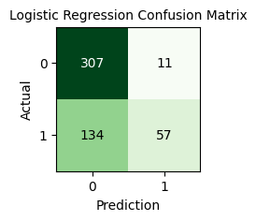
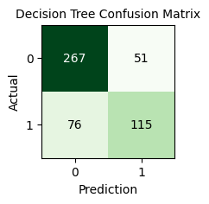
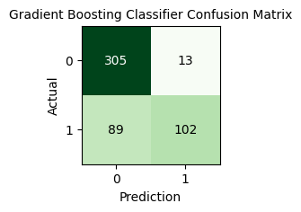
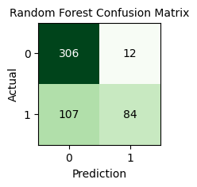
MODELS
LR - 71%
DT - 75%
GBC - 80%
RF - 77%
BERT
Prediction model
BERT
Prediction
model
DATA
TRANSFORMATION
Get Dummies
Vectorized
Label Encoder
Tokenization
Notes:
Logistic Regression, Decision Tree, Gradient Boosting Classifier, and Random Forest are different machine learning algorithms used for classification and regression tasks:
1. **Logistic Regression:**
- Used for binary classification problems.
- It models the probability of a binary outcome by fitting the data to a logistic function.
- Provides the predicted probabilities of a sample belonging to a specific class.
2. **Decision Tree:**
- Non-parametric supervised learning method used for both classification and regression.
- Breaks down a dataset into smaller subsets while creating a tree-like structure, using if-else conditions.
- Provides a clear decision-making model that can be easily visualized.
3. **Gradient Boosting Classifier:**
- An ensemble learning method used for both classification and regression.
- Builds a strong model by combining multiple weak models (usually decision trees).
- The model is built in a stage-wise manner, where each tree corrects the errors of the previous one.
4. **Random Forest:**
- Ensemble learning method that constructs a multitude of decision trees at training time.
- Utilizes the predictions of multiple decision trees to enhance accuracy and control overfitting.
- Randomness is introduced by selecting random subsets of features for each tree.
Each of these models has its strengths and weaknesses. Logistic Regression is simple and fast but assumes linear relationships. Decision Trees are intuitive but can easily overfit. Gradient Boosting combines weak models to form a strong one. Random Forests reduce overfitting by averaging multiple trees.

Slide 18
MODELS
LR - 71%
DT - 75%
GBC - 80%
RF - 77%
def output_lable(n):
if n ==0:
return 'Fake'
elif n==1:
return 'Real'
def manual_testing(news):
testing_news = {'test':[news]}
new_def_test = pd.DataFrame(testing_news)
new_def_test['test'] = new_def_test['text'].apply(wordopt)
new_X_test = new_def_test['text']
new_XV_test = vectorization.transform(new_X_test)
pred_LR = LR.predict(new_XV_test)
pred_DTV = DTV.predict(new_XV_test)
pred_GB = GB.predict(new_XV_test)
pred_RFC = RF.predict(new_XV_test)
return print('\n\nLR Prediction:{} \nDT Prediction: {} \nGBC Predcition: {} \nRFC Prediction: {}'.format(output_lable(pred_LR[0]),
output_lable(pred_GB[0]),
output_lable(pred_RFC[0])))
Prediction model
Notes:
Used code to develop a model to inout articles to assss if its fake or real

Slide 19
MODELS
LR - 71%
DT - 75%
GBC - 80%
RF - 77%
class BERT_Arch(nn.Module):
def __init__(self, bert):
super(BERT_Arch, self).__init__()
self.bert = bert
self.dropout = nn.Dropout(0.1) # dropout layer
self.relu = nn.ReLU() # relu activation function
self.fc1 = nn.Linear(768,512) # dense layer 1
self.fc2 = nn.Linear(512,2) # dense layer 2 (Output layer)
self.softmax = nn.LogSoftmax(dim=1) # softmax activation function
def forward(self, sent_id, mask): # define the forward pass
cls_hs = self.bert(sent_id, attention_mask=mask)['pooler_output']
# pass the inputs to the model
x = self.fc1(cls_hs)
x = self.relu(x)
x = self.dropout(x)
x = self.fc2(x) # output layer
x = self.softmax(x) # apply softmax activation
return x
model = BERT_Arch(bert)
# Defining the hyperparameters (optimizer, weights of the classes and the epochs)
# Define the optimizer
from transformers import AdamW
optimizer = AdamW(model.parameters(),
lr = 1e-5) # learning rate
# Define the loss function
cross_entropy = nn.NLLLoss()
# Number of training epochs
epochs = 2
BERT
Next Steps
Conclusion
Notes:
BERT (Bidirectional Encoder Representations from Transformers) is a powerful natural language processing (NLP) model developed by Google. It is used in machine learning and text analysis tasks, including the detection of fake news. BERT is particularly effective because of its ability to understand the context of words in a sentence or document, which enables it to produce better word embeddings and capture intricate relationships between words.
For fake news detection, BERT can analyze text data to understand the context, semantics, and sentiment within news articles, tweets, or any textual content. By training a model with BERT's embeddings, it can potentially recognize linguistic patterns and markers that indicate unreliable or false information, thus helping in the identification and classification of fake news. When fed with enough labeled data, BERT-based models can learn to distinguish between fake and legitimate news sources. This can contribute to the development of better classification models and aid in detecting misleading or deceptive news content.

Slide 20





Be
SMART
BRAVE
WISE
Rise
UP
Question everything
Speak
out
Next Steps
Conclusion
BERT
Prediction
model
Read
and Research
Seek the TRUTH
Leave a LEGACY
THINK
FOR YOURSELF

Slide 21

Be
SMART
BRAVE
WISE
Rise
UP
Question everything
Work on BERT
Freeze layer
Dense layer
BERT
Prediction model
Speak
out
BERT
Prediction
model
Read
and Research
Conclusion
Seek the TRUTH
Leave a LEGACY
THINK
FOR YOURSELF

Slide 22
Be
SMART
BRAVE
WISE
Rise
UP
Explore
Data
Models
More features
Question everything
Speak
out
BERT
Prediction
model
Read
and Research
Next Step
Seek the TRUTH
Leave a LEGACY
THINK
FOR YOURSELF
Notes:
Explore more of the data and other models

Slide 23
Be
SMART
BRAVE
WISE
Rise
UP
Question everything
Collaboration
Combine models
Speak
out
BERT
Prediction
model
Read
and Research
Conclusion
Seek the TRUTH
Leave a LEGACY
THINK
FOR YOURSELF

Slide 24
Be
SMART
BRAVE
WISE
Rise
UP
Models
Diverse
Balanced
Popularity
Question everything
Speak
out
BERT
Prediction
model
Read
and Research
Conclusion
Seek the TRUTH
Leave a LEGACY
THINK
FOR YOURSELF
Notes:
The data and models utilized can be more diverse and encompass balanced news articles.

Slide 25
Be
SMART
BRAVE
WISE
Rise
UP
Computer limitations
Cost
Running Time
Question everything
Speak
out
BERT
Prediction
model
Read
and Research
Conclusion
Seek the TRUTH
Leave a LEGACY
THINK
FOR YOURSELF
Notes:
The computational constraints experienced while processing the machine learning models significantly affected their runtime and associated costs. This is an essential aspect to take into consideration.

Slide 26
Rise
UP
Question everything
Be
SMART
BRAVE
WISE
Speak
out
Read
and Research
THINK
FOR YOURSELF
Leave a LEGACY
Seek the TRUTH

